Slide 1



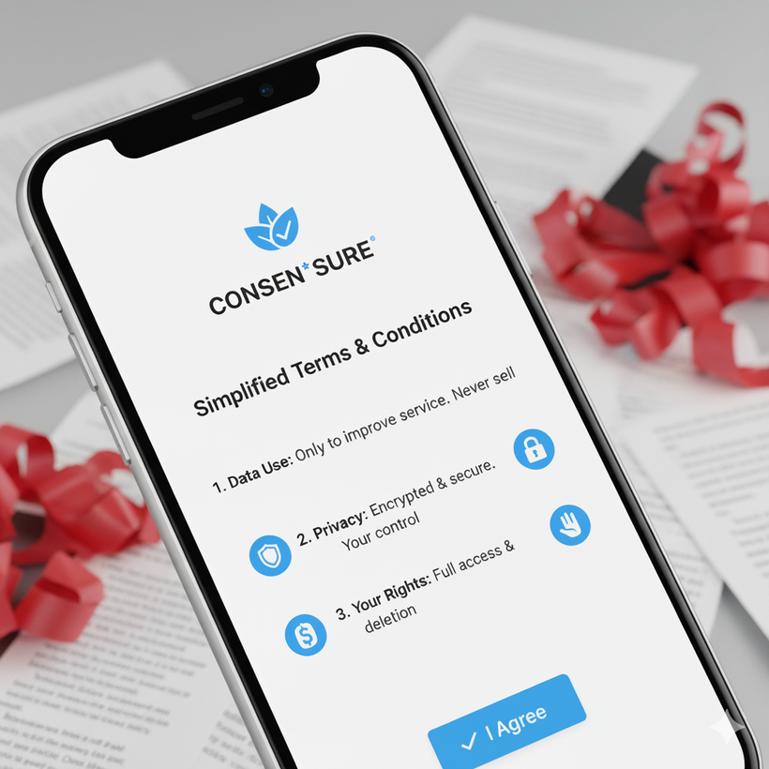


ConsenSure
www.reallygreatsite.com
“Simplifying Digital Consent with AI”
Team: Extropy
An AI-powered platform that simplifies Terms & Conditions into easy-to-understand language — ensuring every user gives informed consent.

Slide 2
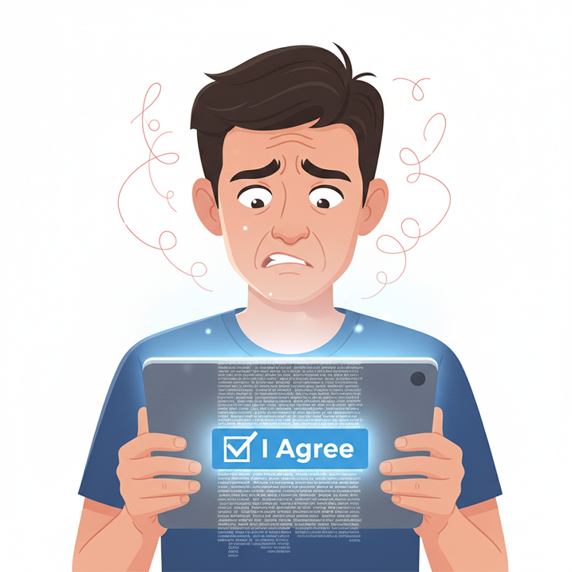

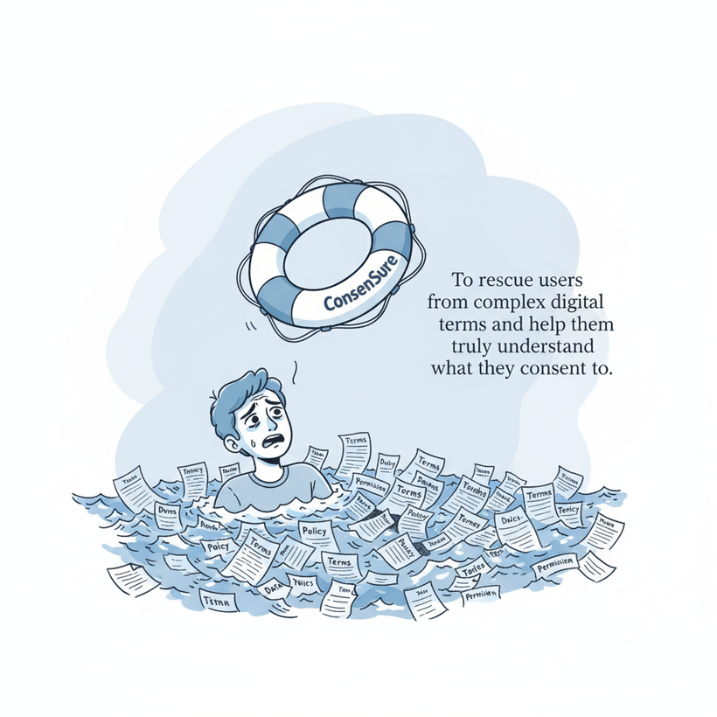
The Problem
90%+ users accept terms without reading them.
Lengthy, legal, and English-heavy T&Cs discourage awareness.
Leads to unaware consent, privacy loss, and data misuse.
Goal:
Make digital consent clear, quick, and comprehensible for all — especially non-technical and rural audiences.

Slide 3
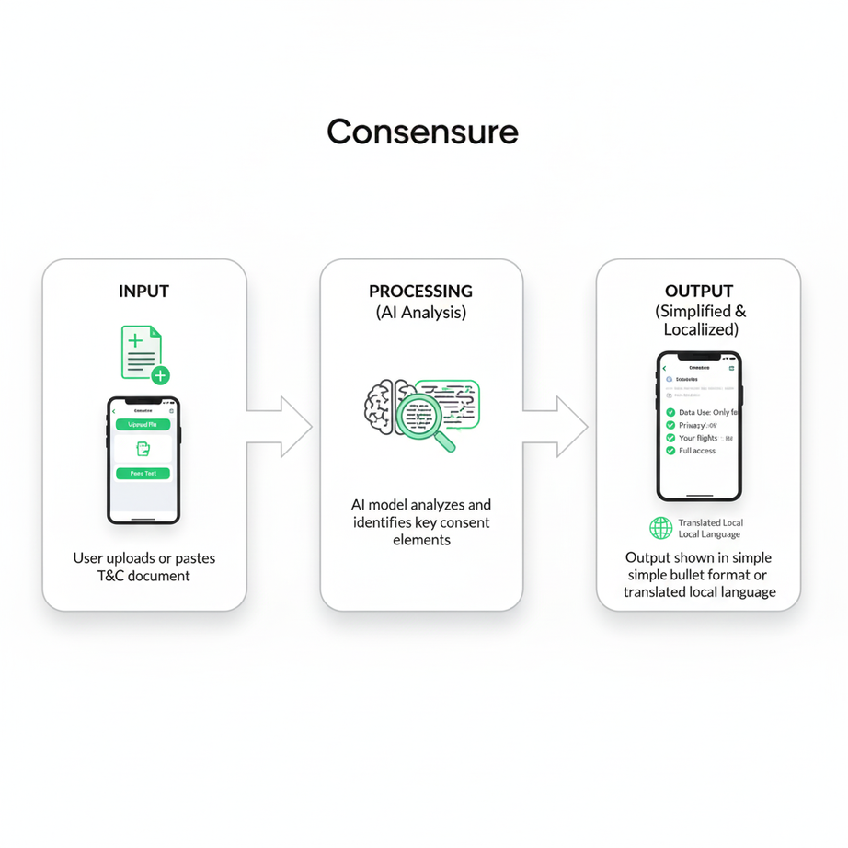

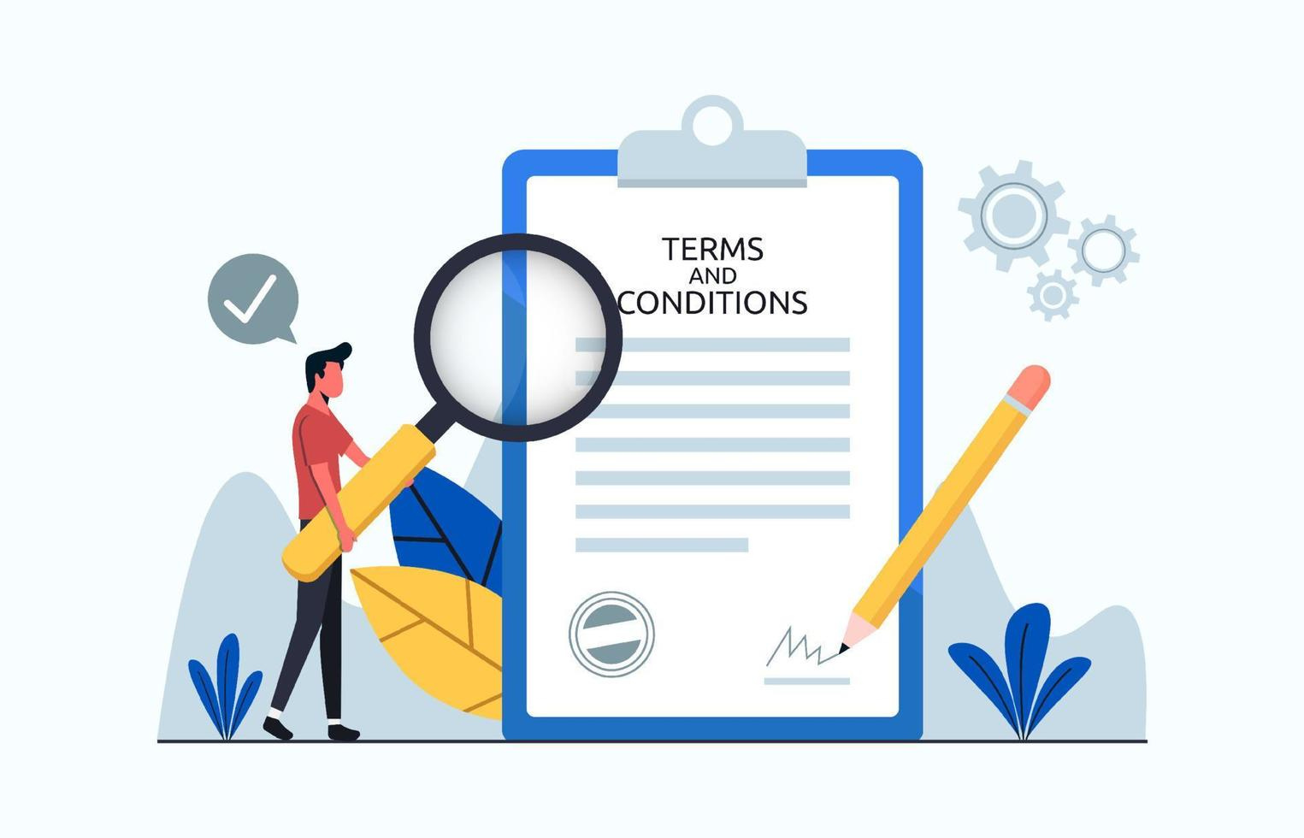
The Prototype: How It Works
Flow Overview:
User uploads or pastes a Terms & Conditions document.
Our AI model analyzes and identifies key consent elements.
Output is shown in simple format or translated local language along with highlighted ratings on various risk factors.
Features:
AI-based summarization (Hugging Face Transformers)
Flask backend with REST API integration
Multi-language support (via translation API)
Highlighted risk and permission zones

Slide 4
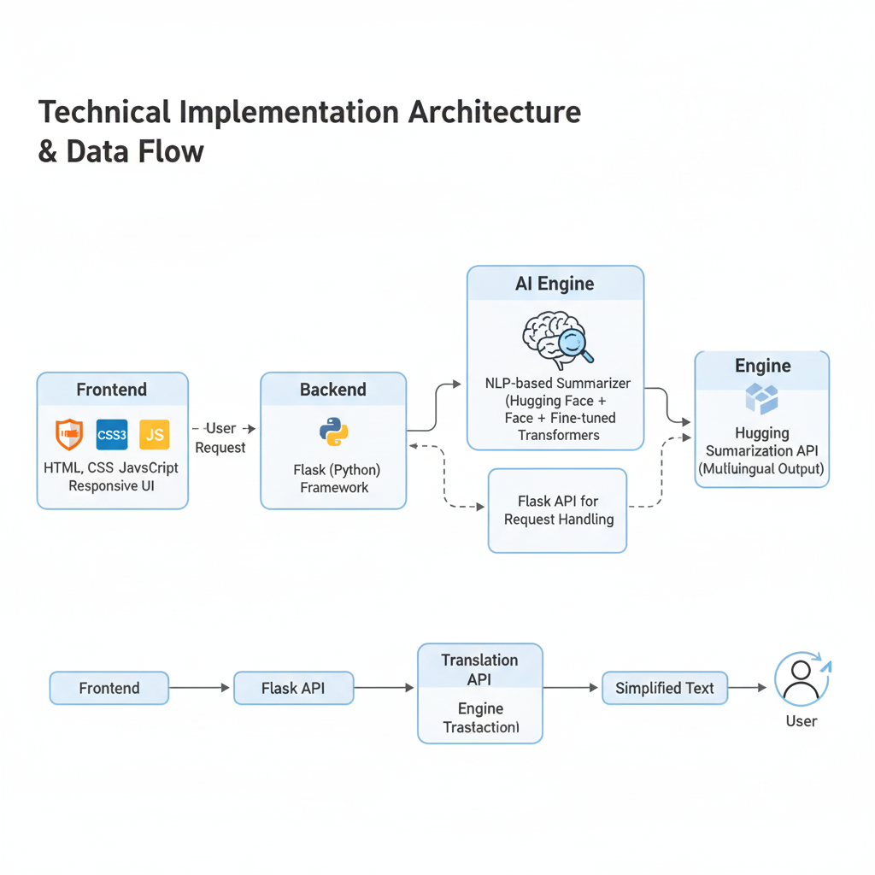






Technical Implementation
FRONTEND
WORKFLOW:
BACKEND
AI Engine
OCR using Tesseract (extracts texts from pictures)

Slide 5
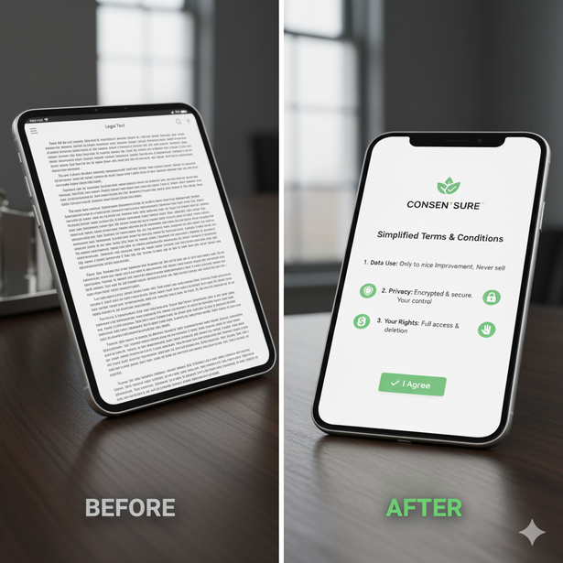

Future scope and conclusion
Uninformed consent in regional and rural communities:
Most rural users still accept permissions blindly because T&Cs are in English.
→ Our goal is to integrate more regional language and voice-based summaries, so even non-English speakers can understand what they’re agreeing to.
Future Enhancements:
Browser Extension for auto-simplification
Mobile App (for easy rural access)
Voice-based summaries for non-readers
Integration with Govt Digital Literacy programs
ConsenSure isn’t just simplifying text, it’s simplifying trust.
Hidden data-sharing practices in modern apps:
Many apps disguise risky data permissions within long legal texts.
→ We plan to enhance our AI to detect and flag hidden risks, like unnecessary camera or location access
Lack of real-time awareness while using apps
Users don’t get any warning when new permissions or updates are added silently.
→ We’ll build a browser extension and mobile notifier that instantly alerts users when an app changes its privacy terms.

